Slide 1
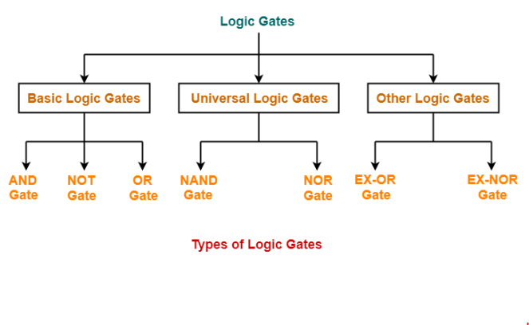

Slide 2
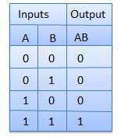

BINARY LOGIC GATES
AND Gate
A circuit which performs an AND operation is shown in figure. It has n input (n >= 2) and one output.
Logic diagram
Truth Table

Slide 3
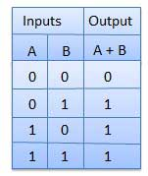

OR Gate
A circuit which performs an OR operation is shown in figure. It has n input (n >= 2) and one output.
Logic diagram
Truth Table

Slide 4
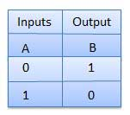

NOT Gate
NOT gate is also known as Inverter. It has one input A and one output Y.
Logic diagram
Truth Table

Slide 5
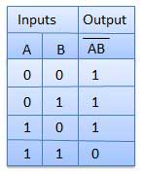

NAND Gate
A NOT-AND operation is known as NAND operation. It has n input (n >= 2) and one output.
Truth Table
Logic diagram

Slide 6
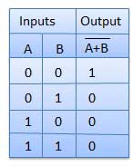

NOR Gate
A NOT-OR operation is known as NOR operation. It has n input (n >= 2) and one output.
Logic diagram

Slide 7
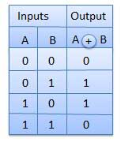

XOR Gate
XOR or Ex-OR gate is a special type of gate. It can be used in the half adder, full adder and subtractor. The exclusive-OR gate is abbreviated as EX-OR gate or sometime as X-OR gate. It has n input (n >= 2) and one output.
Truth Table
Logic diagram

Slide 8
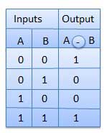

XNOR Gate
XNOR gate is a special type of gate. It can be used in the half adder, full adder and subtractor. The exclusive-NOR gate is abbreviated as EX-NOR gate or sometime as X-NOR gate. It has n input (n >= 2) and one output.
Truth Table
Logic diagram

Slide 9
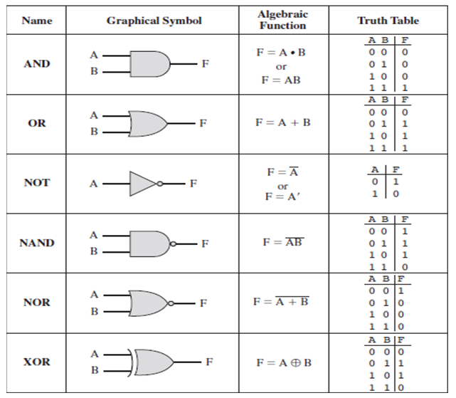

Slide 10
BOOLEAN ALGEBRA
Boolean Algebra is used to analyze and simplify the digital (logic) circuits. It uses only the binary numbers i.e. 0 and 1. It is also called as Binary Algebra or logical Algebra.
Rule in Boolean Algebra
Following are the important rules used in Boolean algebra.
Variable used can have only two values. Binary 1 for HIGH and Binary 0 for LOW.
Complement of a variable is represented by an over bar (-). Thus, complement of variable B is represented as . Thus if B = 0 then = 1 and B = 1 then = 0.
OR ing of the variables is represented by a plus (+) sign between them. For example OR ing of A, B, C is represented as A + B + C.
Logical ANDing of the two or more variable is represented by writing a dot between them such as A.B.C. Sometime the dot may be omitted like ABC.

Slide 11
Boolean Laws
There are six types of Boolean Laws.
Commutative law
Any binary operation which satisfies the following expression is referred to as commutative operation.
law states that changing the sequence of the variables does not have any effect on the output of a logic circuit.
Associative law
This law states that the order in which the logic operations are performed is irrelevant as their effect is the same.

Slide 12
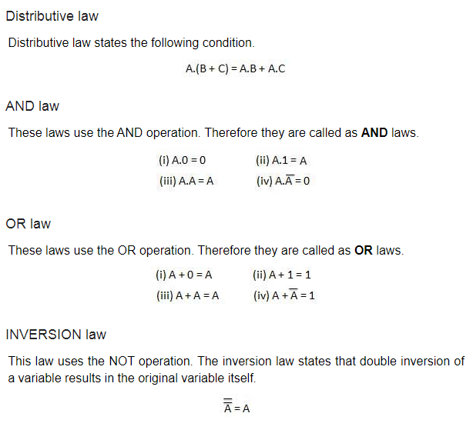

Slide 13
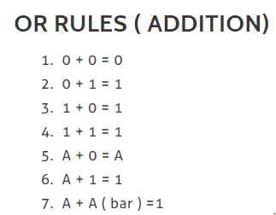
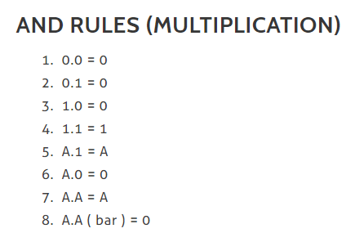

Slide 14

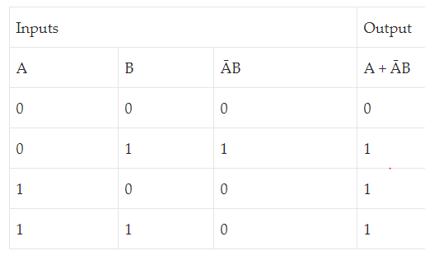
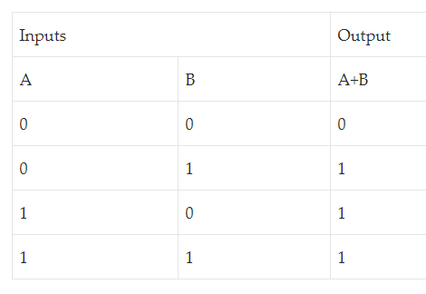
REDUNDANT LITERAL RULE:

Slide 15
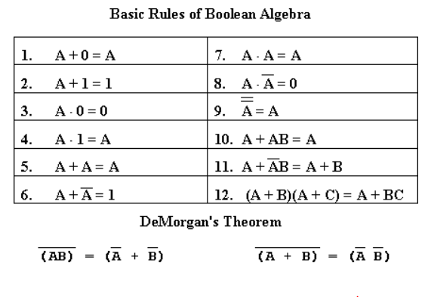

Slide 16
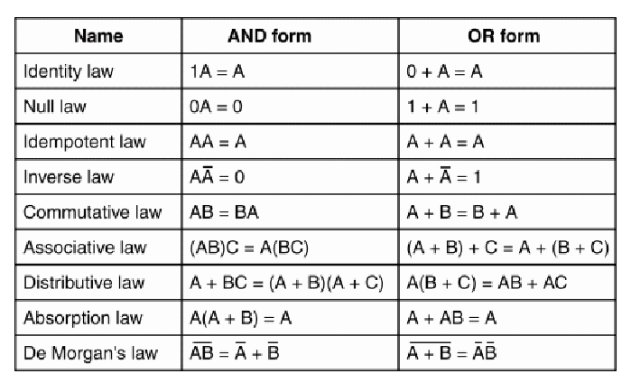

Slide 17
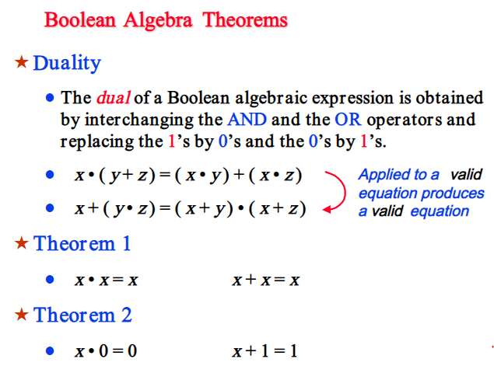

Slide 18
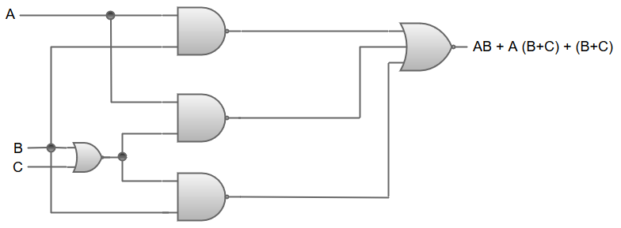
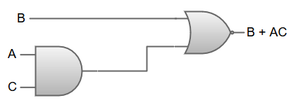
Let us consider an example of a Boolean function:
AB+A (B+C) + B (B+C)
The logic diagram for Boolean function B + AC can be represented as:
AB + A (B+C) + B (B+C)
AB + AB + AC + BB + BC {Distributive law; A (B+C) = AB+AC, B (B+C) = BB+BC}
AB + AB + AC + B + BC {Idempotent law; BB = B}
AB + AC + B + BC {Idempotent law; AB+AB = AB}
AB + AC +B {Absorption law; B+BC = B}
B + AC {Absorption law; AB+B = B}

Slide 19
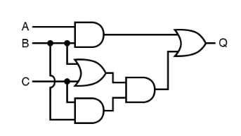
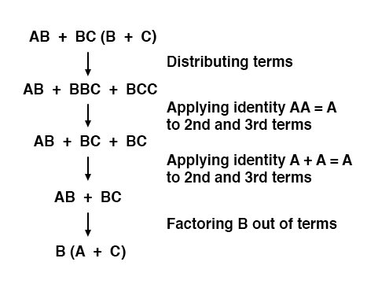
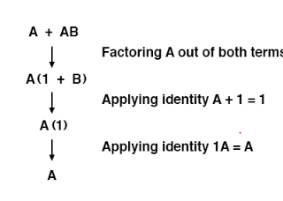
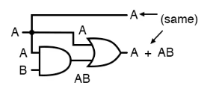
EXAMPLE 2
EXAMPLE 3

Slide 20
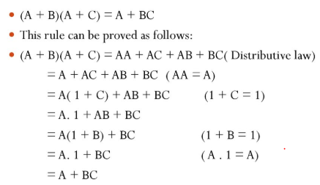
Example 4

Slide 21
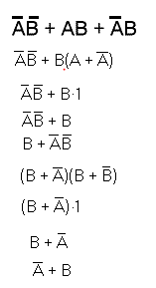
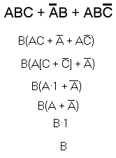
Example 5
Example 6
BB+BB’+A’B+A’B’
B+0+A’(B+B’)
B+0+A’.1
B+A’

Slide 22
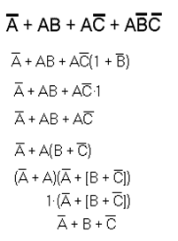
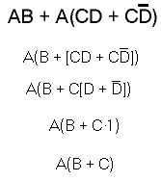
Example 7
Example 8

Slide 23

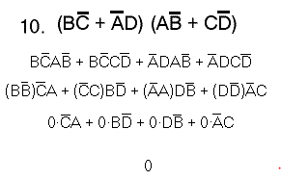
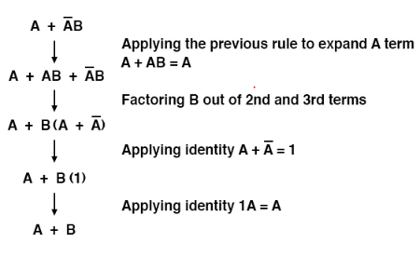
Example 9

Slide 24
